Slide 1
NIMH Strategic Objectives
Define the mechanisms of complex behaviors
Chart mental illness trajectories to determine when, where, and how to intervene
Strive for prevention and cures
Strengthen the public health impact of NIMH-supported research

Slide 2
NIMH Objective 3: Strive for prevention and cures
Develop new treatments based on discoveries in genomics, neuroscience, and behavioral science
Develop ways to tailor existing and new interventions to optimize outcomes
Test interventions for effectiveness in community practice settings

Slide 3
NIMH Objective 4: Strengthen public health impact
Improve the efficiency and effectiveness of existing mental health services
Establish research-practice partnerships to improve dissemination, implementation, and continuous improvement of evidence-based mental health services
Develop innovative service delivery models to improve dramatically the outcomes of mental health services in diverse communities and populations
Develop new capacity for research that evaluates public health impact of mental health services

Slide 4
ISMICC: Make it easier to get good care
2.1: Define and implement a national standard for crisis care
2.2: Develop a continuum of care that includes…community-based alternatives to hospitalization
2.6: Prioritize early identification and intervention for children & youth
2.7: Use telehealth and other technologies to improve access
2.8: Maximize the capacity of the behavioral health workforce (including peer providers)
2.9: Support families and caregivers
2.10: Expect SMI and SED screening to occur in all primary care settings

Slide 5
ISMICC: Close gap between what works and what is offered
3.1.a: Promote appropriate use of clozapine and long-acting injectable antipsychotic medications
3.1.c: Team-based models of care delivery that incorporate peer and family support specialists
3.1.c: Team-based models of care delivery that incorporate peer and family support specialists
3.1.e: Bidirectional integrated mental health and primary care services
3.1.e: Psychiatric crisis response using least restrictive settings
3.3: Make coordinated specialty care for FEP available nationwide
3.7: Advance national adoption of effective suicide prevention strategies

Slide 6
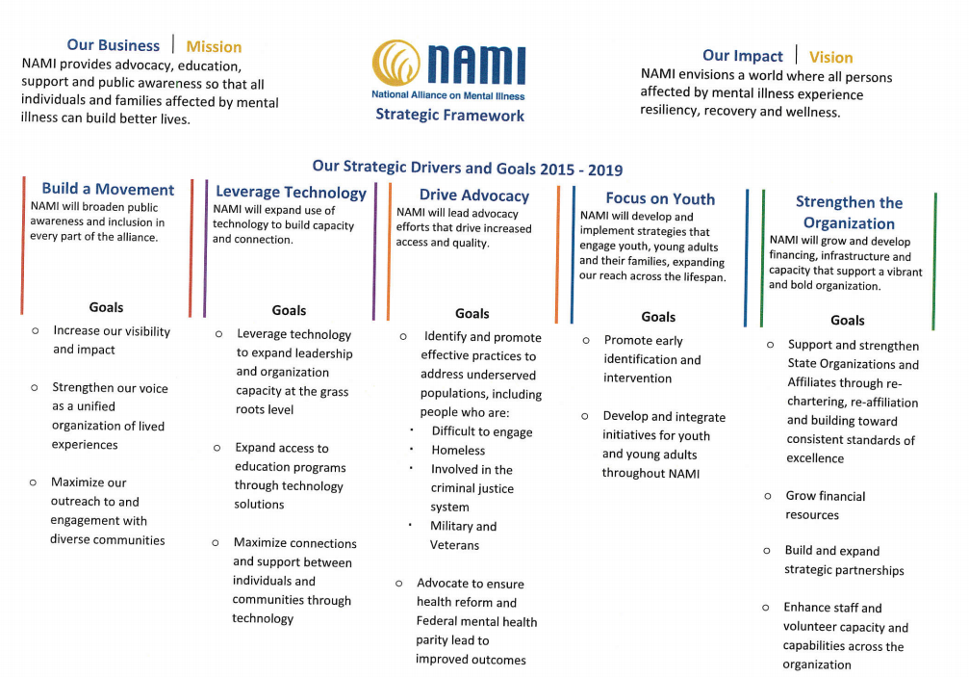

Slide 7
DBSA Strategic Plan
Peer Focus
Outcome: Help people who have mood disorders lead full, meaningful lives
Goals:
Broaden access to quality peer support and peer support services for both individuals and their parents and other partners (family, friends, etc.)
Increase access to, and quality of, treatments and services
Promote adoption of personal wellness strategies among affected individuals and their parents and other partners (family, friends, etc.)
Educate individuals about mood disorders and avenues towards improved health
Inspire and empower individuals with mood disorders to seek, achieve, and sustain wellness
Advocacy
Outcome: Influence positive change in the way the world views mental health
Goals:
Empower individuals and their parents and other partners (family, friends, etc.) to help themselves and others through service and engagement
Increase public knowledge and understanding of mood disorders
Foster productive partnerships between clinicians and people with mood disorders
Influence public policy through government education and advocacy
Improve individuals with mental health conditions’ experiences in the workplace

Slide 8
National Action Alliance for Suicide Prevention themes:
Foster positive public dialogue; counter shame, prejudice, and silence; and build public support for suicide prevention;
Address the needs of vulnerable groups, be tailored to the cultural and situational contexts in which they are offered, and seek to eliminate disparities;
Be coordinated and integrated with existing efforts addressing health and behavioral health and ensure continuity of care;
Promote changes in systems, policies, and environments that will support and facilitate the prevention of suicide and related problems;
Bring together public health and behavioral health;
Promote efforts to reduce access to lethal means among individuals with identified suicide risks;
Apply the most up-to-date knowledge base for suicide prevention

Slide 9
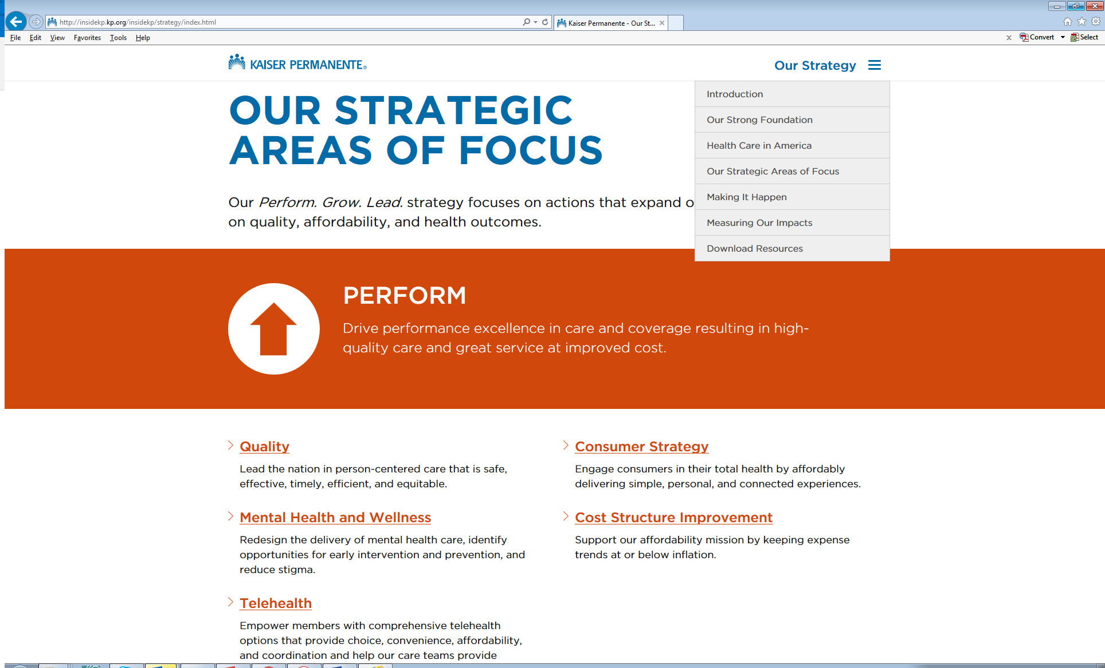

Slide 10
NCQA HEDIS measures
Depression screening in adults and adolescents
Antidepressant medication adherence
Use of PHQ9 to monitor depression outcomes
Depression remission or response
F/U care for children prescribed ADHD medication
F/U after ED visit for mental illness or self-harm
Metabolic monitoring for adults and children taking antipsychotics
Adherence to antipsychotic medication for people with schizophrenia
Psychosocial care prior to antipsychotics in children
Use of multiple antipsychotic medications in adults and children

Slide 11
ALACRITY Centers: MHRN as laboratory
Univ of
Washington
Penn
MHRN

Slide 12
EPINET: MHRN as technical resource
Coordinating
Center
Regional
Hubs
MHRN

Slide 13
HEAL Initiative Collaborative Care
Active projects
  ZS Implementation and opioid reduction programs
  Extension of risk prediction models to opioid exposures and outcomes
Relevant experience
  Seattle collaborative care trials
  CMMI COMPASS
  Collaboratory PPACT
  NIDA CTN PROUD
New pragmatic trial (watch this space)

Slide 14
MHRN and national research networks
FDA
Sentinel
PCORI
CDRNs
MHRN
NIH
Collaboratory
AllofUs
NIDA
CTN

Slide 15
MHRN and other health systems
Southcentral
Foundation
VHA
MHRN
Providence
Epic

Slide 16
MHRN and policy
Action Alliance
for Suicide
Prevention
NCQA
HEDIS
MHRN
NASEM
SAMHSA

